Slide 1

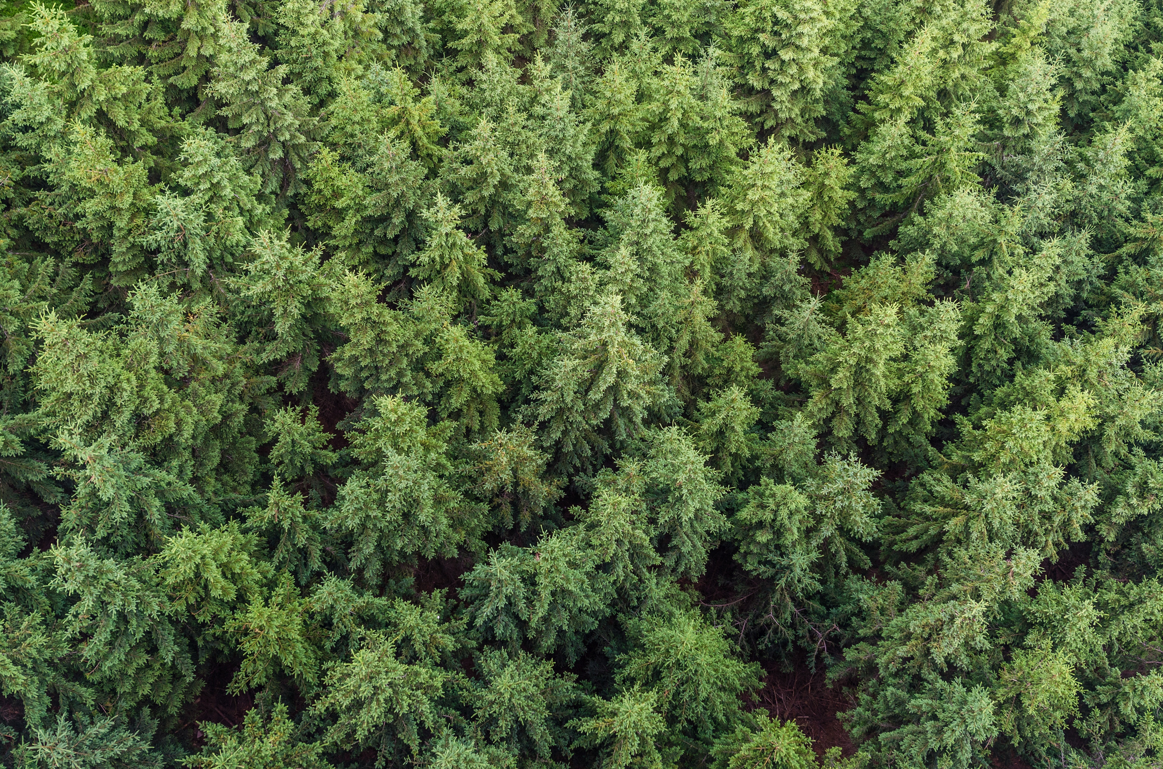




RILHAMAP

Slide 2



650,000 KM
2
OF LAND ONCE SUITABLE FOR AGRICULTURE OR INTENSIVE GRAZING HAS BEEN LOST OVER THE LAST 50 YEARS.
https://www.worldwildlife.org/threats/deforestation-and-forest-degradation

Slide 3

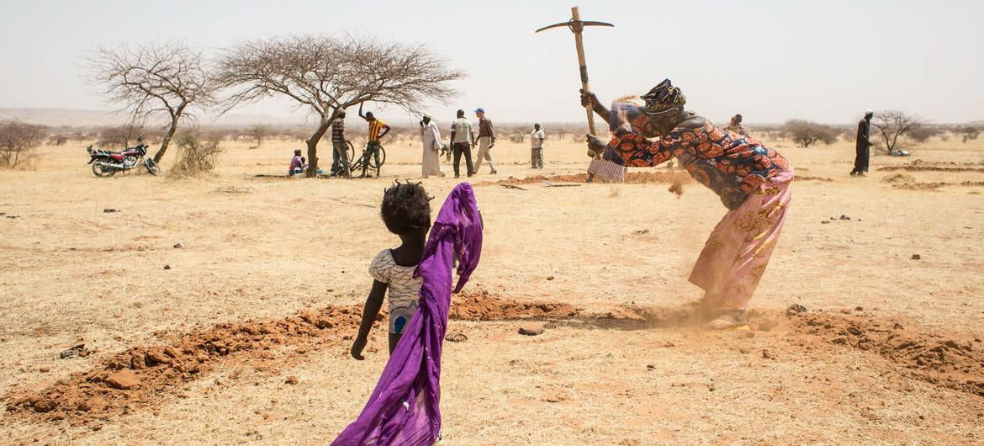
¿WHO IS MARIE?
“I’m a woman from Nigeria, i live near Sahel”
“The degradation of sahel is problematic for vegetation”
“We dont have resurces due the farmers competition ”
“There are deforestation, precipitation of water,population issues we cant see ”

Slide 4
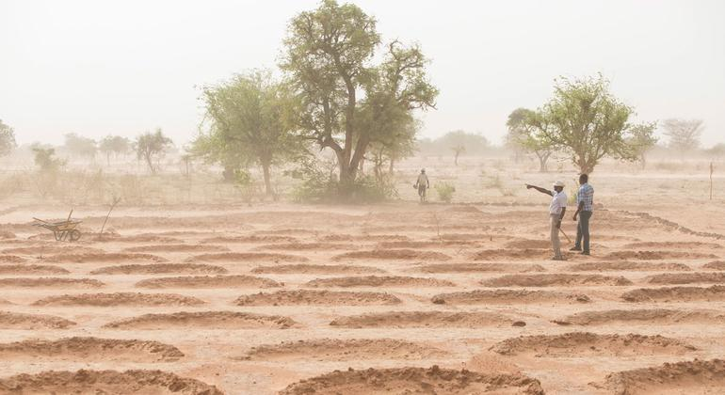
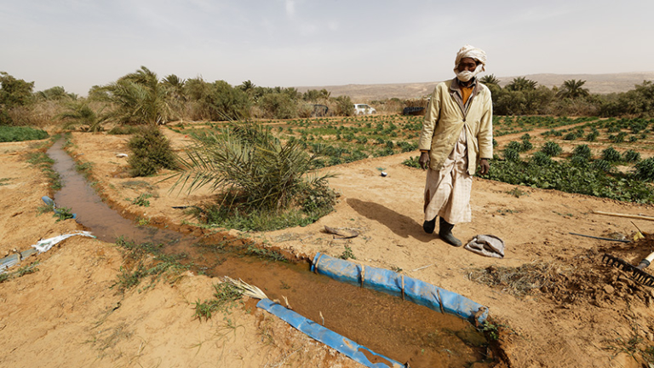
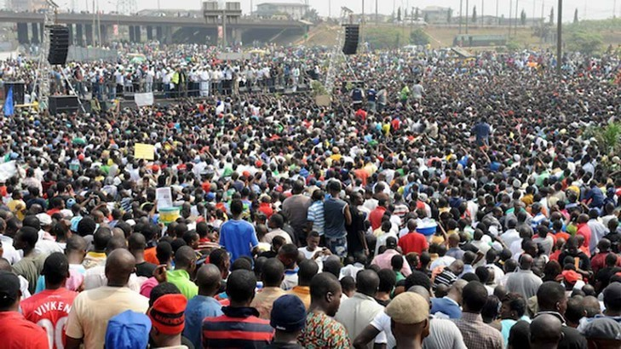

THE PROBLEM
LAND DEGRADATION
WATER PRECIPITATION
POPULATION

Slide 5
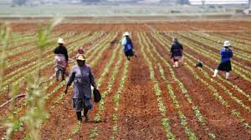
OUR DATASET PLUS
ACCESS OF FOOD

Slide 6

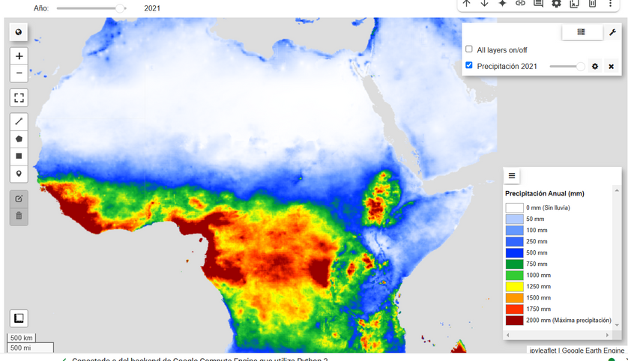
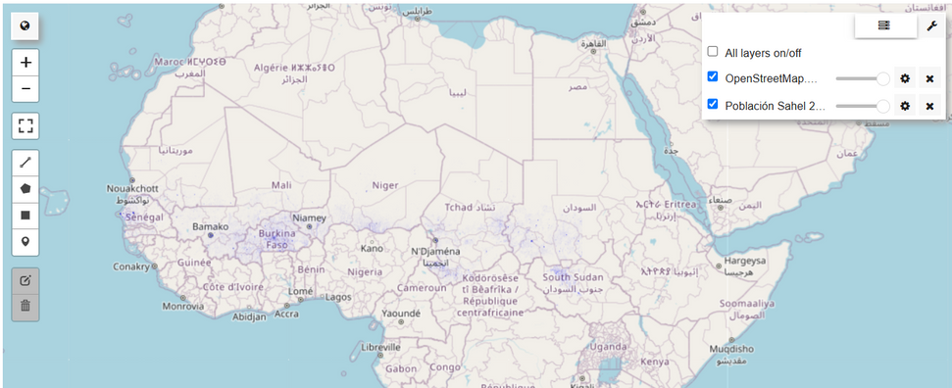
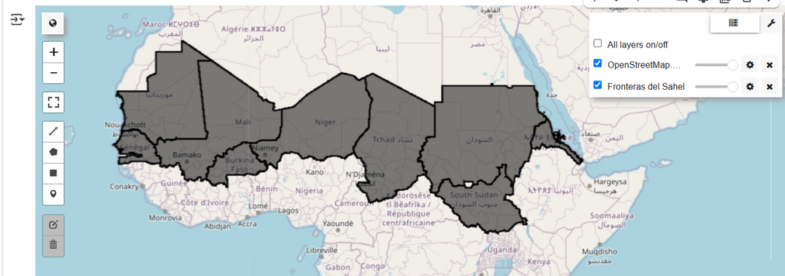
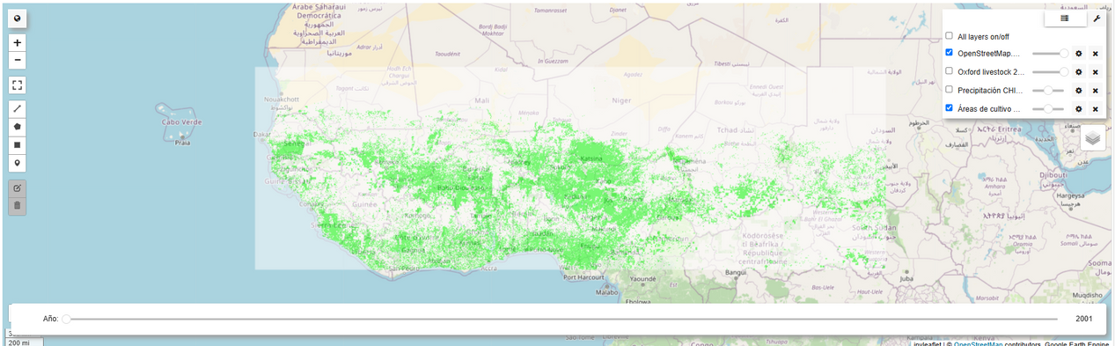
WHAT DO WE DO?

Slide 7
WHAT DO WE HAVE?
Precipicitation of water by time
Population
Food access
Territories

Slide 8

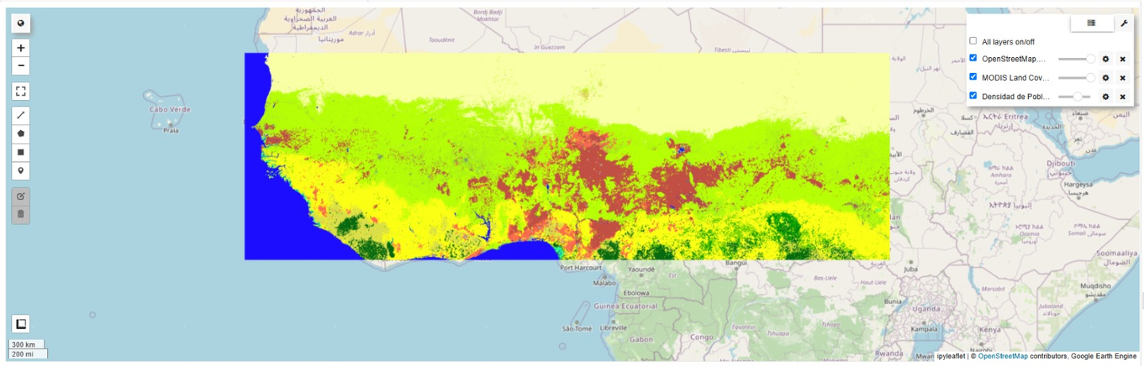
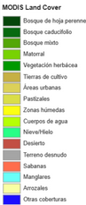
URBANIZATION & DEMOGRAPHICS
WHAT DO WE HAVE?:
+
HOTSPOTS OF CHANGE OF POPULATION/ URBANIZATION
=

Slide 9
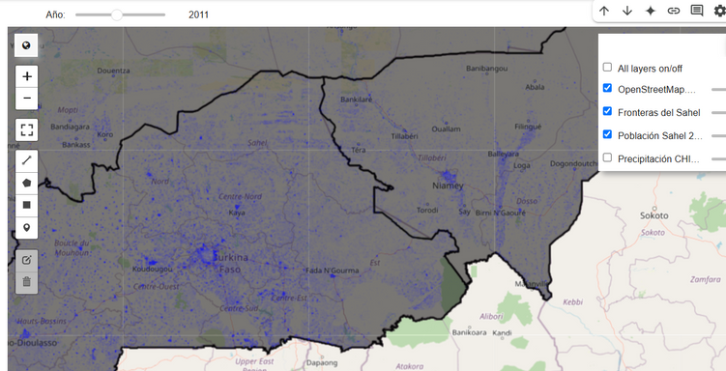
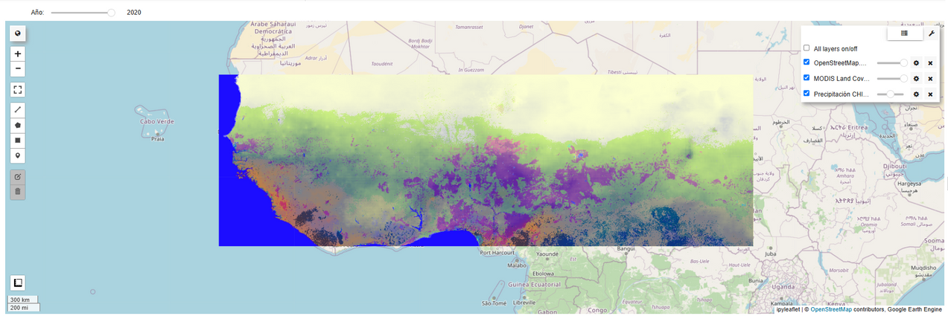
Deforestation + Precipitations
WHAT DO WE DO?:
+
USING EO DATA FOR LAND & WATER CONFLICTS
=

Slide 10
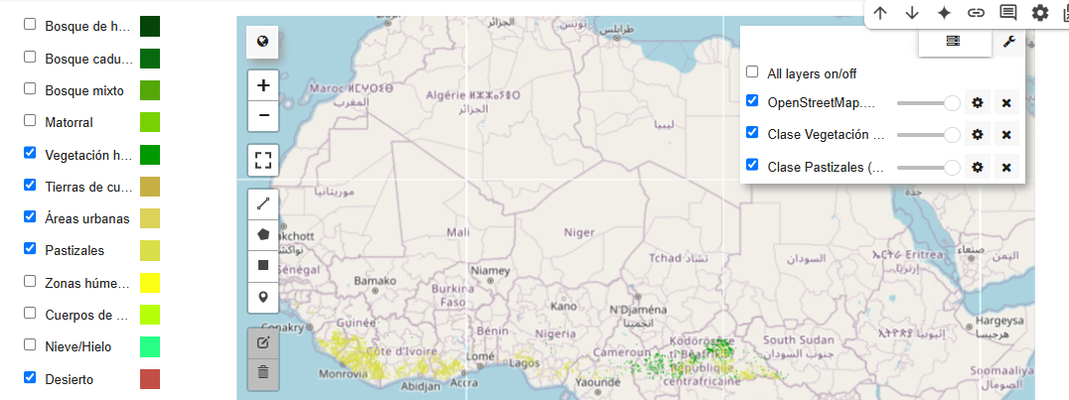
WHAT DO WE DO?: TYPES OF LAND

Slide 11
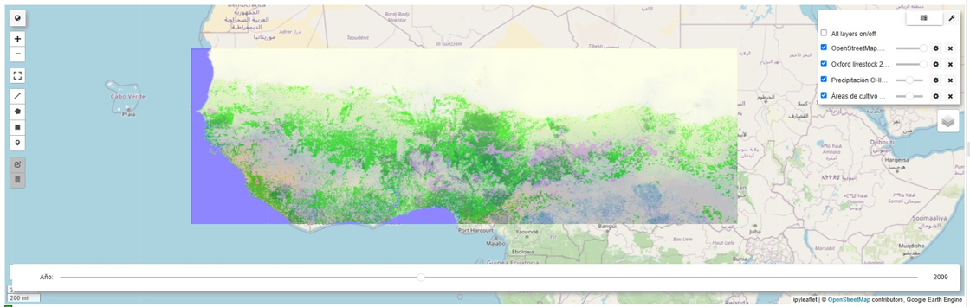
WHAT DO WE DO?: ACCESS OF FOOD
+
AGRICULTURE/PRODUCTION AND ACCESS TO FOOD
=

Slide 12
METHODOLOGY

Slide 13
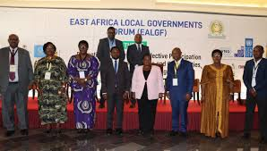






¿WHO WOULD USE IT?
Governant
conects with community leaders and inform about status of weather, vegetation, animal herding, population
community leader
community leader
community leader
community leader
community
community
community
community

Slide 14
RESULTS

Slide 15
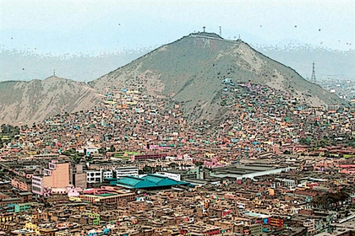


Earth observation data to analyze the trends in land cover
Escalable to other countries
Rilha
Identify places with issues driven by factors like deforestation, desertification, water scarcity, and population growth to give recomendations
Combine datasets and find their relations and patterns

Slide 16
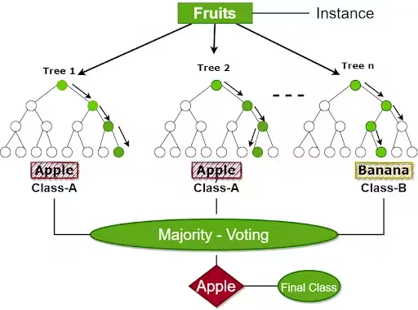
MODEL: RANDOM FOREST
Each tree is trained on a random subset of the data and tries to predict the target (e.g., future precipitation)
Great for capturing complex relationships between features (like year, temperature, soil moisture, etc.) and the target (precipitation or deforestation)
Prevent overfitting, a common problem with simpler models with many features or noisy data.
The algorithm builds multiple trees with different subsets of the data. It explores many possibilities

Slide 17
¿DID WE ANSWER YOUR QUESTIONS?
KEY TRENDS AND LAND COVER CHANGES: OVER 20 YEARS WE IDENTIFY PATTERNS OF PRECIPITATION AND ALSO CATTLE THEFT
HOW HOTSPOTS OF VEGETATION AND URBAN EXPANSION : POPULATION IN EACH DISTRICT AND VEGETATION THROUGH THE YEARS
HOW CAN WE APPROACH THIS GLOBALLY:
INFORM COMMUNITY LEADERS AND GOVERNERS OF INDIGENOUS
GIVE RECOMMENDATIONS FOR WORLDWIDE FARMERS DURING ALL MONTHS.
HELP TAKING DECISIONS: FARMERS KNOW THE TIME OF YEAR FOR, POPULATION, VEGETATION, PRECIPITATIONS, ANIMAL HERDING SO THEY CAN PREVENT AND ALSO INFORM THEIR OWN COMMUNITY.

Slide 18
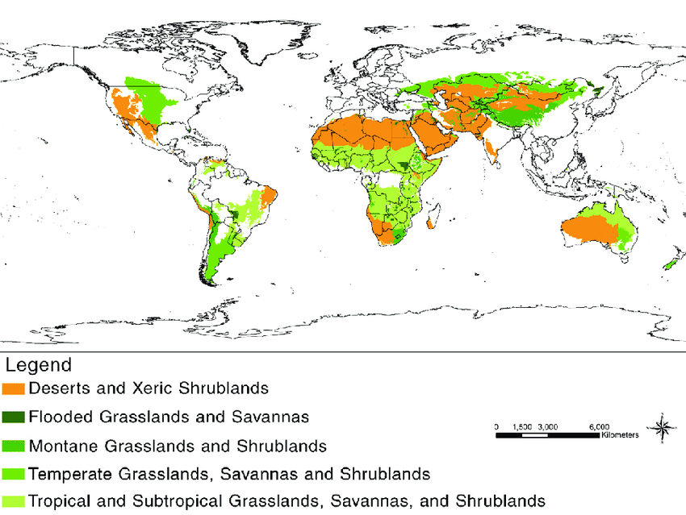
SAHEL IS THE BEGGINING
WE STILL NEED TO HELP THE ENTIRE WORLD

Slide 19
Thanks

